Slide 1


FINAL PROJECT
TEST AUTOMATION
GV: Huynh Thi Kim Ngoc
Pham Dang Nguyen
520H0390
Duong Ngoc Bao Yen
520H0599

Slide 2



GROUP PLAN
Note
Delegated Tasks

Slide 3


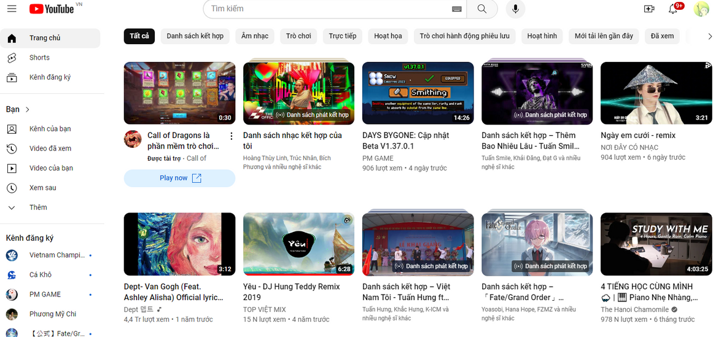
Pizza 53 Demo website
Luma Demo website
Youtube website
WEBSITE FOR TESTING

Slide 4


In Desktop
You have installed the lastest version of Test TestArchitect
You have an account for License Server
Your computer has connect to the Internet
Setting up your "Scale and Layout" computer by 100%
Prerequisites
You have installed the Google Chrome
Whenever switching to another network, you may need to logout and relogin TestArchitect License servers using your cred as your IP is cached

Slide 5
In ‘Chrome’ app
Latest version of Chrome
Turn of 'Save and fill address' and 'Save Password' settings
Pre Conditions
Close all tab website before excuting project
In ‘Test Architect Client’ app
In ‘Final_Projects’ projects
Before executing all Test Case please read "Pre-Condition of Testcase: TC - PDW05"
Please sign out your mail in 'Chrome' website
In ‘Final_Youtube’ projects

Slide 6
Using: TDTU mail to access links below
Dekegated Task
https://docs.google.com/spreadsheets/d/1beLjYEgVhsQtrX_U7UMkh2srG7GsRcqCrPU5-y5-4dI/edit?usp=sharing
Test Requirement, TC, TCs
https://docs.google.com/spreadsheets/d/1pfvW_tZlwR19J9OUaPW6mERpSzbMfPiHmVYTQQeTgn4/edit?usp=sharing
Link
Video demo for results TC
https://drive.google.com/drive/folders/1RtCmYEZUUHGNG-Xneu_kaBSe-Wders1P?usp=sharing

Slide 7

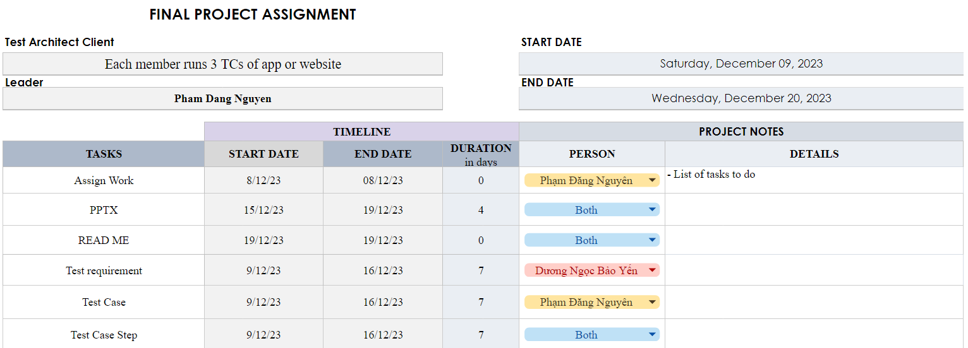
Delegated Task

Slide 8
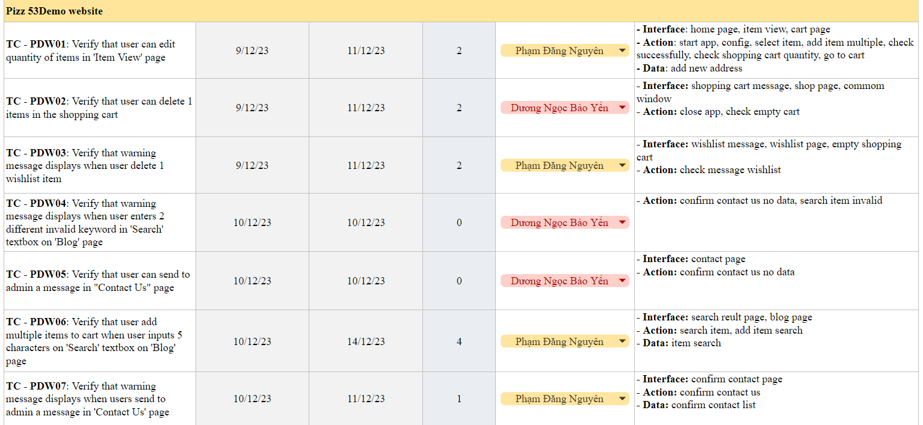

Slide 9
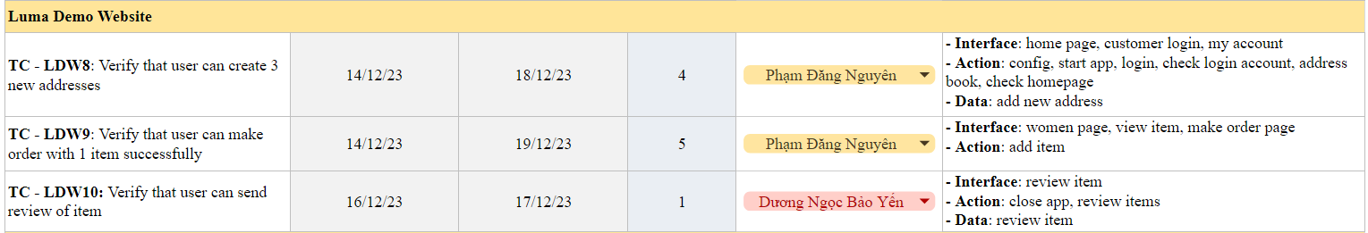
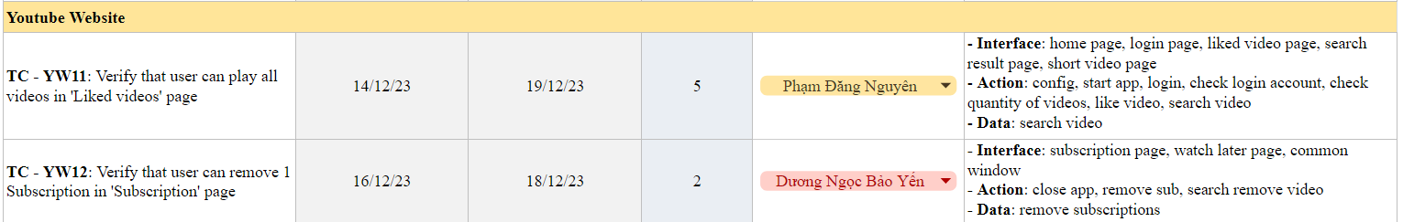

Slide 10


Thanks for Watching

